Slide 1
Software Re-Engineering
Code Reengineering

Slide 2
Refactoring
Refactoring is a systematic process of improving code without creating new functionality that can transform a mess into clean code and a simple design.

Slide 3
Dirty Code
Dirty code is result of inexperience multiplied by tight deadlines, mismanagement, and nasty shortcuts taken during the development process.

Slide 4
Clean Code
Clean code is code that is easy to read, understand, and maintain. Clean code makes software development predictable and increases the quality of the resulting product.

Slide 5
Refactoring Process
Performing refactoring step-by-step and running tests after each change are key elements of refactoring that make it predictable and safe.

Slide 6
Refactoring Techniques
Refactoring techniques describe actual refactoring steps. Most refactoring techniques have their pros and cons. Therefore, each refactoring should be properly motivated and applied with caution

Slide 7
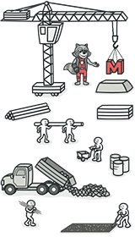
1.Composing Methods
The refactoring techniques in this group streamline methods, remove code duplication, and pave the way for future improvements.

Slide 8
void printDebt(double amount) {
// Print Banner
System.out.println("*****************");
System.out.println("** Customer Debt **");
System.out.println("*****************");
// Print Details
System.out.println("name: " + name);
System.out.println("amount: " + amount);
}

Slide 9
void printDebt(double amount) {
printBanner();
printDetails(amount);
}
void printBanner() {
System.out.println("*****************");
System.out.println("** Customer Debt **");
System.out.println("*****************");
}

Slide 10
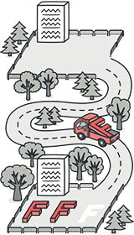
2. Moving Features between Objects
Even if you have distributed functionality among different classes in a less-than-perfect way, there is still hope.
These refactoring techniques show how to safely move functionality between classes, create new classes, and hide implementation details from public access.

Slide 11
Technique: Move Method
Dirty Code (Feature Envy): A method uses the data of another class more than its own.
class Account {
private AccountType type;
private int daysOverdrawn;
// This method belongs more to AccountType
double overdraftCharge() {
if (type.isPremium()) {
return daysOverdrawn * 1.75;
}
return daysOverdrawn * 0.5;
}
}

Slide 12
Refactored: Moves the logic to the class that actually owns the data.
class AccountType {
double overdraftCharge(int daysOverdrawn) {
if (isPremium()) return daysOverdrawn * 1.75;
return daysOverdrawn * 0.5;
}
}

Slide 13
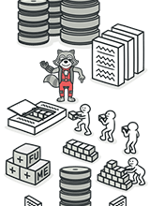
3.Organizing Data
These refactoring techniques help with data handling, replacing primitives with rich class functionality. Another important result is the untangling of class associations, which makes classes more portable and reusable.

Slide 14
Technique: Replace Primitive with Object
Dirty Code (Primitive Obsession): Using a primitive for a concept that has its own logic.
// Students often use simple Strings for complex things
String phone = "5550199";

Slide 15
class PhoneNumber {
private String areaCode;
private String number;
// Allows for validation logic and formatting
public String getFormatted() { return "(" + areaCode + ") " + number; }
}

Slide 16
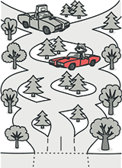
4.Simplifying Conditional Expressions
Conditionals tend to get more and more complicated in their logic over time, and there are yet more techniques to combat this as well.

Slide 17
Technique: Decompose Conditional
Dirty Code: Complicated "if" statements that become a "mess" over time.
if (date.before(SUMMER_START) || date.after(SUMMER_END)) {
charge = quantity * winterRate + winterServiceCharge;
} else {
charge = quantity * summerRate;
}

Slide 18
if (isSummer(date)) {
charge = summerCharge(quantity);
} else {
charge = winterCharge(quantity);
}

Slide 19
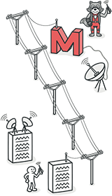
5. Simplifying Method Calls
These techniques make method calls simpler and easier to understand. This, in turn, simplifies the interfaces for interaction between classes.

Slide 20
Technique: Replace Parameter with Explicit Methods
Dirty Code: A single method that uses a flag to decide what to do (confusing interface).
void setValue(String name, int value) {
if (name.equals("height")) { height = value; return; }
if (name.equals("width")) { width = value; return; }
}

Slide 21
void setHeight(int value) { height = value; }
void setWidth(int value) { width = value; }

Slide 22
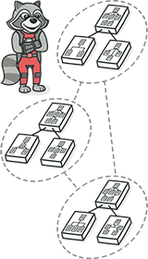
6. Dealing with Generalization
Abstraction has its own group of refactoring techniques, primarily associated with moving functionality along the class inheritance hierarchy, creating new classes and interfaces, and replacing inheritance with delegation and vice versa.

Slide 23
Technique: Pull Up Field/Method
Dirty Code (Duplicate Code): Two subclasses have the exact same field or method.
class Employee { }
class Salesman extends Employee { private String name; }
class Engineer extends Employee { private String name; }

Slide 24
class Employee { protected String name; }
class Salesman extends Employee { }
class Engineer extends Employee { }

Slide 25
Code Smells
— What? How can code "smell"?? — Well, it doesn't have a nose... but it definitely can stink!

Slide 26
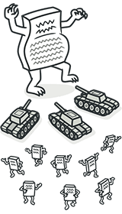
1. Bloaters
Bloaters are code, methods and classes that have increased to such gargantuan proportions that they are hard to work with. Usually these smells do not crop up right away, rather they accumulate over time as the program evolves (and especially when nobody makes an effort to eradicate them).
Long Method
Large Class
Primitive Obsession
Long Parameter List
Data Clumps

Slide 27
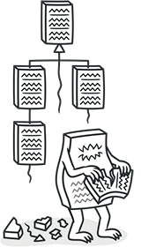
2. Object-Orientation Abusers
All these smells are incomplete or incorrect application of object-oriented programming principles.
Alternative Classes with Different Interfaces
Refused Request
Switch Statements
Temporary Field

Slide 28
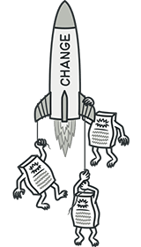
3. Change Preventers
These smells mean that if you need to change something in one place in your code, you have to make many changes in other places too.
Program development becomes much more complicated and expensive as a result.
Divergent Change
Parallel Inheritance Hierarchies
Shotgun Surgery

Slide 29
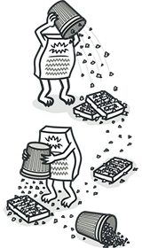
4. Dispensable
A dispensable is something pointless and unneeded whose absence would make the code cleaner, more efficient and easier to understand.
Comments
Duplicate Code
Data Class
Dead Code
Lazy Class
Speculative Generality

Slide 30
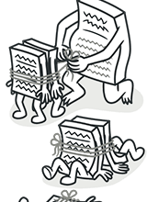
5. Couplers
All the smells in this group contribute to excessive coupling between classes or show what happens if coupling is replaced by excessive delegation.
Feature Envy
Inappropriate Intimacy
Incomplete Library Class
Message Chains
Middle Man

Slide 31
How to refactor
Refactoring should be done as a series of small changes, each of which makes the existing code slightly better while still leaving the program in working order.

Slide 32



Checklist of refactoring done right way
The code should become cleaner.
New functionality shouldn’t be created during refactoring.
All existing tests must pass after refactoring.

